Slide 1

© 2002, Cisco Systems, Inc. All rights reserved.

Slide 2
Managing IP Traffic with Access Lists
Module 6
Notes:
Purpose: This chapter introduces the Cisco IOS™ CLI on the Catalyst® 1900 switch and router.
Timing: This chapter should take about 2 hours to present.
Note: The Catalyst 1900 switch only has a subset of the router Cisco IOS commands available.
Contents:
Introduction to Cisco IOS. Explain to the student what is IOS?
Cisco Device startup procedures in general.
IOS configuration source.
General introduction to the IOS CLI.
Cat 1900 switch startup procedures.
Intro to Cat 1900 CLI. This part covers the basic configuration on the switch, like setting the IP address and hostname. More details about the various Cat 1900 switch configuration commands are explained in Chapter 6 and 7.
Router startup procedures. More details on the router startup process is discussed in chapter 5.
Router IOS CLI.

Slide 3
Objectives
Upon completing this module, you will be able to:
  Use Cisco IOS commands to configure standard and extended IP access lists, and NAT/PAT, given a functioning router
  Use show commands to identify anomalies in standard and extended IP access lists, given an operational router
Notes:
Slide 1 of 2
Purpose: This slide states the chapter objectives.
Emphasize: Read or state each objective so that each student has a clear understanding of the chapter objectives.
Note: Catalyst switches have different CLIs. The Catalyst 2900xl and the Catalyst 1900 has a Cisco IOS CLI. The Cisco IOS CLI commands available on the 2900xl is different from the 1900. The Catalyst 5000 family has no Cisco IOS CLI, and use the set commands instead. This class only covers the configuration on the Catalyst 1900 switch.

Slide 4

Access Lists and Their Applications
© 2002, Cisco Systems, Inc. All rights reserved.
Notes:
Purpose: This chapter introduces the Cisco IOS™ CLI on the Catalyst® 1900 switch and router.
Timing: This chapter should take about 2 hours to present.
Note: The Catalyst 1900 switch only has a subset of the router Cisco IOS commands available.
Contents:
Introduction to Cisco IOS. Explain to the student what is IOS?
Cisco Device startup procedures in general.
IOS configuration source.
General introduction to the IOS CLI.
Cat 1900 switch startup procedures.
Intro to Cat 1900 CLI. This part covers the basic configuration on the switch, like setting the IP address and hostname. More details about the various Cat 1900 switch configuration commands are explained in Chapter 6 and 7.
Router startup procedures. More details on the router startup process is discussed in chapter 5.
Router IOS CLI.

Slide 5
Objectives
Upon completing this lesson, you will be able to:
  Explain the purpose of access lists and identify potential applications
  Describe how the Cisco IOS software processes standard and extended access lists on inbound and outbound interfaces
Notes:
Slide 1 of 2
Purpose: This slide states the chapter objectives.
Emphasize: Read or state each objective so that each student has a clear understanding of the chapter objectives.
Note: Catalyst switches have different CLIs. The Catalyst 2900xl and the Catalyst 1900 has a Cisco IOS CLI. The Cisco IOS CLI commands available on the 2900xl is different from the 1900. The Catalyst 5000 family has no Cisco IOS CLI, and use the set commands instead. This class only covers the configuration on the Catalyst 1900 switch.

Slide 6
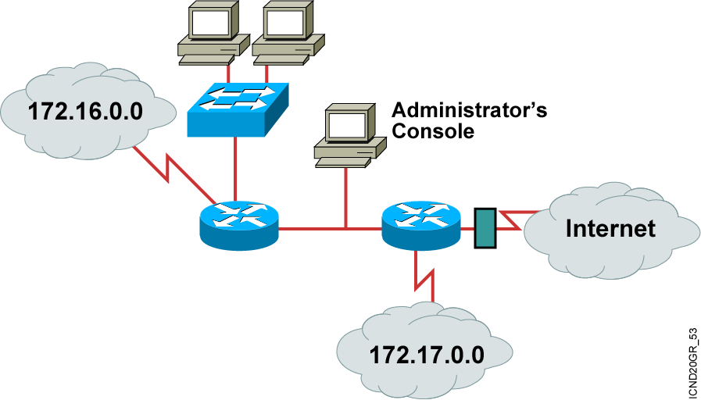
Why Use Access Lists?
  Manage IP traffic as network access grows
  Filter packets as they pass through the router
Notes:
Layer 2 of 2
Emphasize: An access list is a mechanism for identifying particular traffic. One application of an access list is for filtering traffic into or out of a router interface.

Slide 7
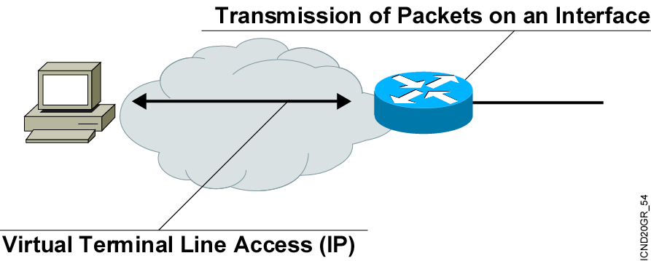
Access List Applications
  Permit or deny packets moving through the router.
  Permit or deny vty access to or from the router.
  Without access lists, all packets could be transmitted onto all parts of your network.
Notes:
Purpose: This figure illustrates common uses for IP access lists.
Emphasize: While this chapter focuses on IP access lists, the concept of access lists as mechanisms to control traffic in a network applies to all protocols.
Note: An improved security solution is the lock-and-key access feature, which is available only with IP extended access lists. Lock-and-key access allows you to set up dynamic access lists that grant access per user to a specific source/destination host through a user authentication process. You can allow user access through a firewall dynamically, without compromising security restrictions.
Transition: The following figure is the first of a three-layer build that presents other uses of access lists specific to Cisco IOS™ features.

Slide 8
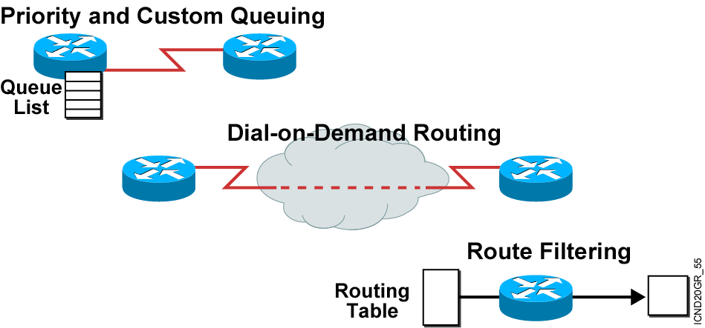
Other Access List Uses
Special handling for traffic based on packet tests
Notes:
Layer 3 of 3
Purpose: This figure is the last layer of the build for other uses of access lists.
Emphasize: Access lists are used to define input traffic for route filtering to restrict the contents of routing updates.
Transition: The following figure is a two-layer build to show the difference between inbound and outbound access lists.

Slide 9
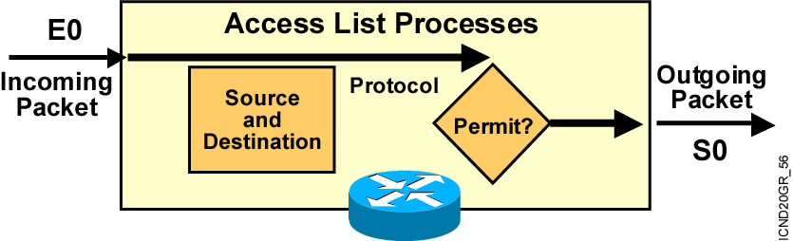
Types of Access Lists
  Standard
    Checks source address
    Generally permits or denies entire protocol suite
  Extended
    Checks source and destination address
    Generally permits or denies specific protocols
Notes:
Layer 3 of 3
Purpose: Describe an inbound versus outbound access list on an interface.

Slide 10
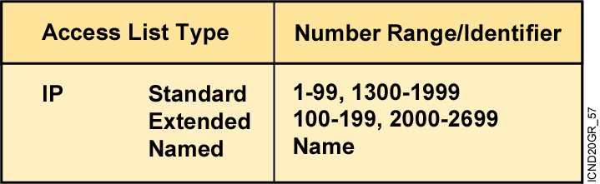
How to Identify Access Lists
  Standard IP lists (1-99) test conditions of all IP packets from
  source addresses.
  Extended IP lists (100-199) test conditions of source and destination addresses, specific TCP/IP protocols, and destination ports.
  Standard IP lists (1300-1999) (expanded range).
  Extended IP lists (2000-2699) (expanded range).
  Other access list number ranges test conditions for other
  networking protocols.
Notes:
Layer 3 of 3
Emphasize: Layer 3—Adds the Novell IPX access lists covered in Chapter 11, “Configuring Novell IPX,” and the number ranges for these types of access lists. As of Release 11.2.4(F), IPX also supports named access lists.
Point out that number ranges generally allow 100 different access lists per type of protocol. When a given hundred-number range designates a standard access list, the rule is that the next hundred-number range is for extended access lists for that protocol.
Exceptions to the numbering classification scheme include AppleTalk and DECnet, where the same number range can identify various access list types.
For the most part, number ranges do not overlap between different protocols.
Note: With Cisco IOS 12.0, the IP access-lists range has been expanded to also include:
<1300-1999> IP standard access list (expanded range)
<2000-2699> IP extended access list (expanded range)

Slide 11
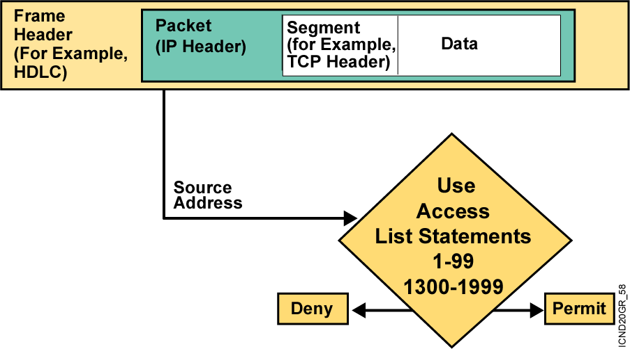
Testing Packets with
Standard Access Lists
Notes:
Purpose: This graphic gives an overview of the type of TCP/IP packet tests that standard access lists can filter. It uses the encapsulation graphic and diamond decision graphic to remind students of material presented earlier in this course.

Slide 12
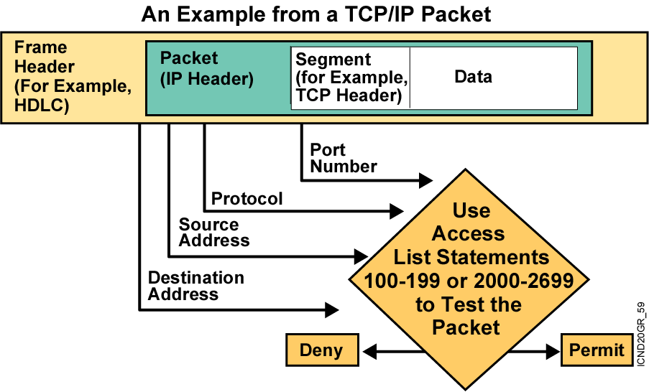
Testing Packets with
Extended Access Lists
Notes:
Purpose: This graphic gives an overview of the type of TCP/IP packet tests that extended access lists can filter. It uses the encapsulation graphic and diamond decision graphic to remind students of material presented earlier in this course.

Slide 13
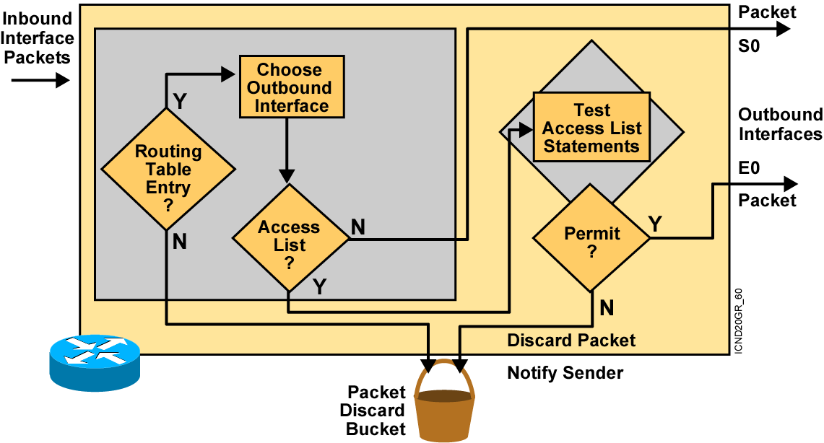
Outbound ACL Operation
  If no access list statement matches, then discard the packet.
Notes:
Layer 3 of 3
Purpose: Shows a deny result of the access list test.
Emphasize: Now the packet is discarded into the packet discard bucket. The unwanted packet has been denied access to the outbound interface.
The Notify Sender message shows a process like ICMP, returning an “administratively prohibited” message back to the sender.

Slide 14
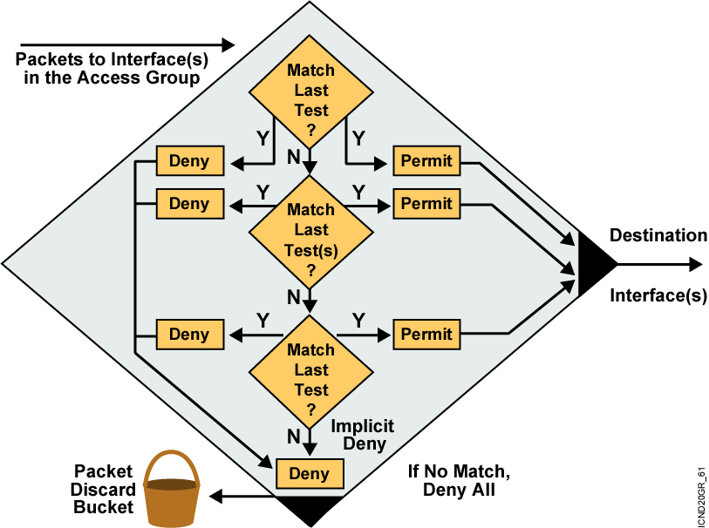
A List of Tests: Deny or Permit
Notes:
Layer 4 of 4
Purpose: Shows the implicit “deny all.”
Emphasize: Describe the final access list test to match any packets not covered by earlier access list statements. All remaining packets match the “Implicit Deny” and are discarded into the bit bucket.

Slide 15
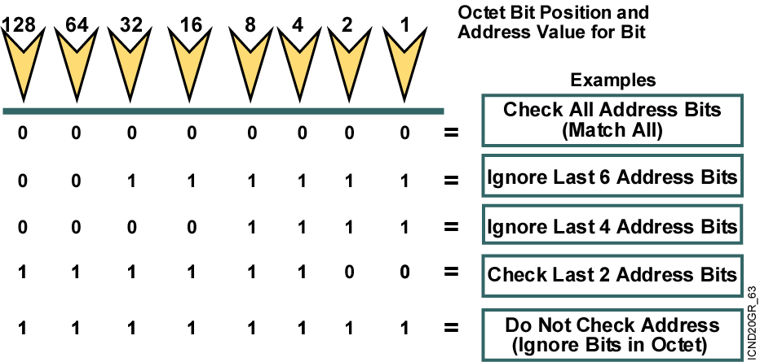
Wildcard Bits: How to Check the Corresponding Address Bits
  0 means check value of corresponding address bit.
  1 means ignore value of corresponding address bit.
Notes:
Purpose: This graphic describes the binary wildcard masking process.
Emphasize: Introduce the wildcard bit process. Tell students that the wildcard bit matching process is different than the IP subnet addressing mask covered earlier.
Illustrate how wildcard masking works using the examples shown in the graphic table.
The term wildcard masking is a nickname for this access list mask-bit-matching process. This nickname comes from an analogy of a wildcard that matches any other card in a poker game.
Emphasize the contrast between wildcard masks and subnet masks, stated in the Student Guide note. The confusion over wildcard and subnet masks can be a key obstacle to learning if students fail to understand the different uses of binary 0 and binary 1 in the two mask types.
Point out that the 1 bits in a wildcard mask need not be contiguous, while the 1 bits in a subnet mask need to be contiguous.
Wildcard is like the DOS “*” character.

Slide 16
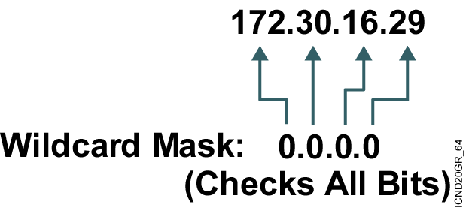
Wildcard Bits to Match a Specific IP Host Address
Check all the address bits (match all).
Verify an IP host address, for example:
  For example, 172.30.16.29 0.0.0.0 checks all the
  address bits.
  Abbreviate this wildcard mask using the IP address preceded by the keyword host (host 172.30.16.29).
Notes:
Purpose: This graphic shows students how to use the host abbreviation in the extended access list wildcard mask.
Emphasize: This abbreviation means check the bit value in all bit positions, which has the effect of matching only the specified IP host address in all bit positions.

Slide 17

Wildcard Bits to Match Any IP Address
Test conditions: Ignore all the address bits (match any).
An IP host address, for example:
  Accept any address: any
  Abbreviate the expression using the
  keyword any.
Notes:
Purpose: This graphic shows students how to use the wildcard any abbreviation.
Emphasize: This abbreviation means ignore any bit value in all bit positions, which has the effect of matching anything in all bit positions.

Slide 18
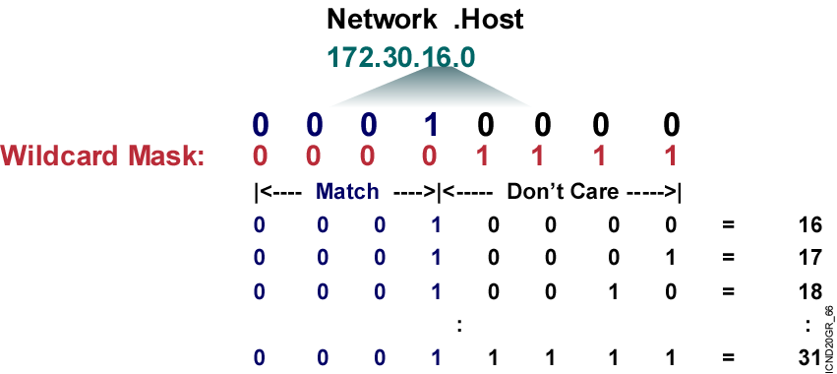
Wildcard Bits to Match IP Subnets
Check for IP subnets 172.30.16.0/24 to 172.30.31.0/24.
  Address and wildcard mask:
  172.30.16.0 0.0.15.255
Notes:
Purpose: This slide describes an example of how wildcard mask bits will match all hosts on subnets 172.30.16.0/24 to 172.30.31.0/24.
Emphasize: This process requires a thorough understanding of binary numbering, what values to use in the power of two bit positions, and how to convert a number from decimal to binary.
If some of your students seem to lack this understanding, tell them that responsibility for complex access list design is an advanced configuration skill. Later, this course offers a hands-on lab to allow practice designing simple access lists.
If you feel that your students need another example to improve their understanding of the process, prepare another example as a chalk talk. Consider having students volunteer to help as you solve your own example that lines up the binary bits of the address and the binary bits of the wildcard mask.

Slide 19
Summary
  Access lists offer a powerful tool for network control. These lists add the flexibility to filter the packet flow into or out of router interfaces. Such control can help limit network traffic and restrict network use by certain users or devices.
  An IP access list is a sequential list of permit and deny conditions that apply to IP addresses or upper-layer IP protocols. Access lists filter traffic going through the router, but they do not filter traffic originated from the router.
  Access lists are optional mechanisms in Cisco IOS software that you can configure to filter or test packets to determine whether to forward them to their destination or discard them.
Notes:
Purpose: This slide discuss the initial configurations on the routers and switches.
Note: There is no setup mode on the Catalyst 1900 switch.

Slide 20
Summary (Cont.)
  Inbound access lists process incoming packets before they are routed to an outbound interface, while outbound access lists process packets to an outbound interface.
  The Cisco IOS software executes access list statements in sequential order, so the first statement is processed, then the next, and so on.
  Address filtering occurs using access list address wildcard masking to identify how to check or ignore corresponding IP address bits.

Slide 21


